Slide 1
Qutee Robot

Slide 2
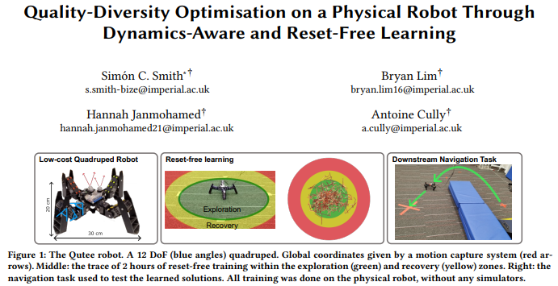
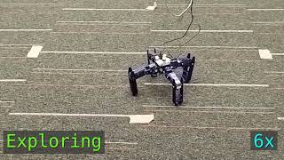
https://www.youtube.com/watch?v=BgGNvIsRh7Q

Slide 3
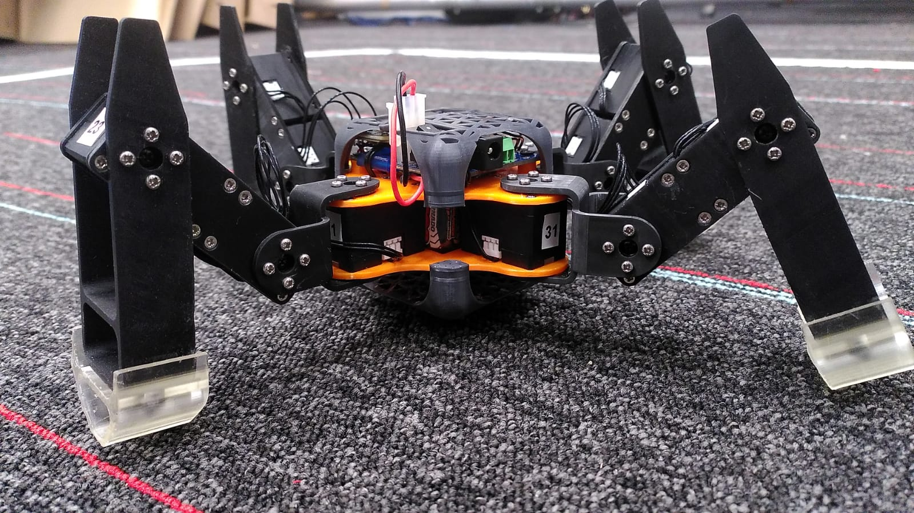
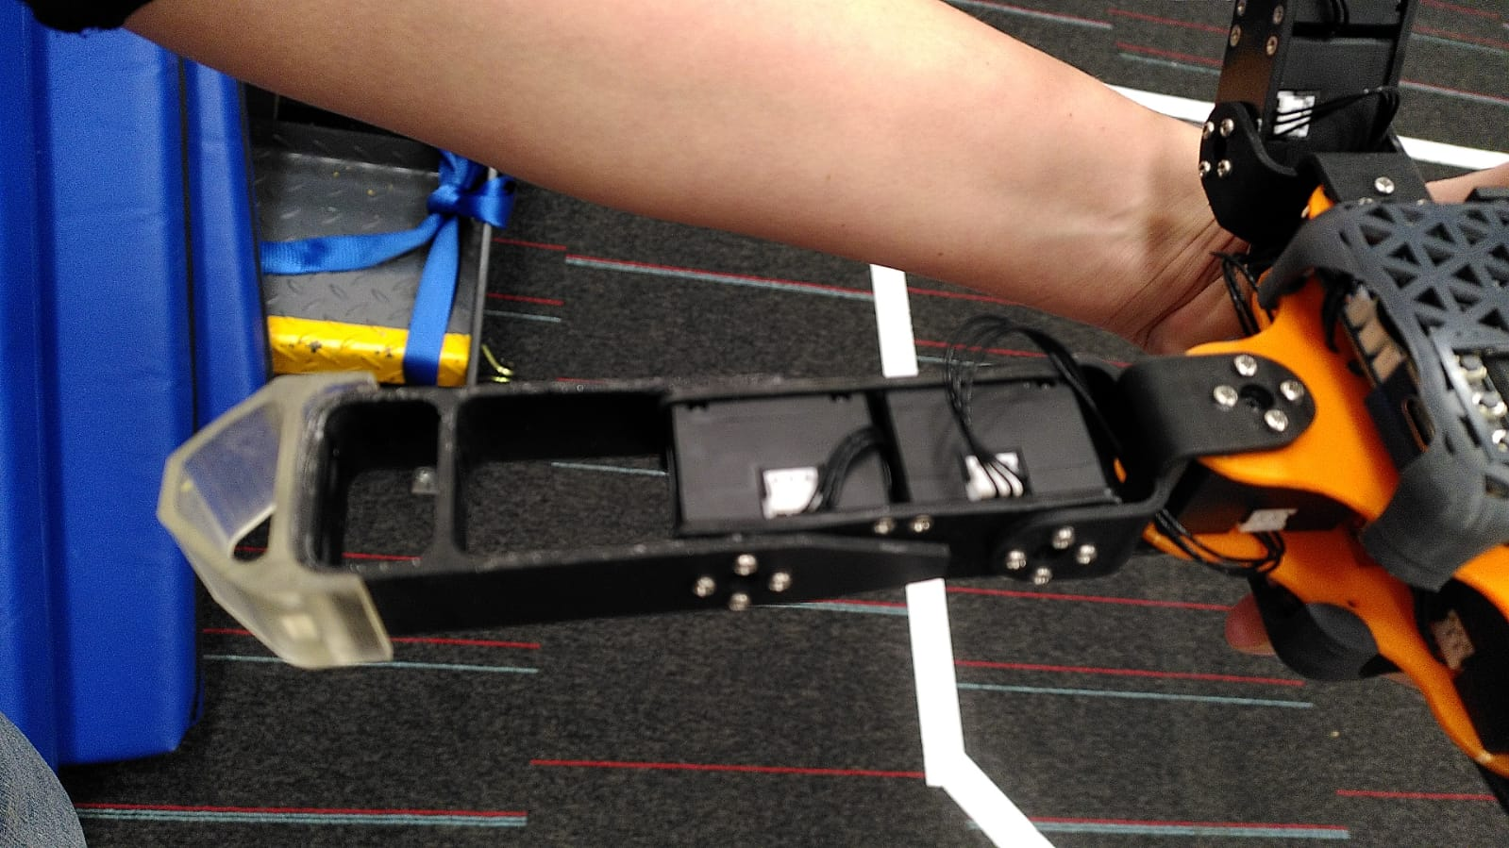
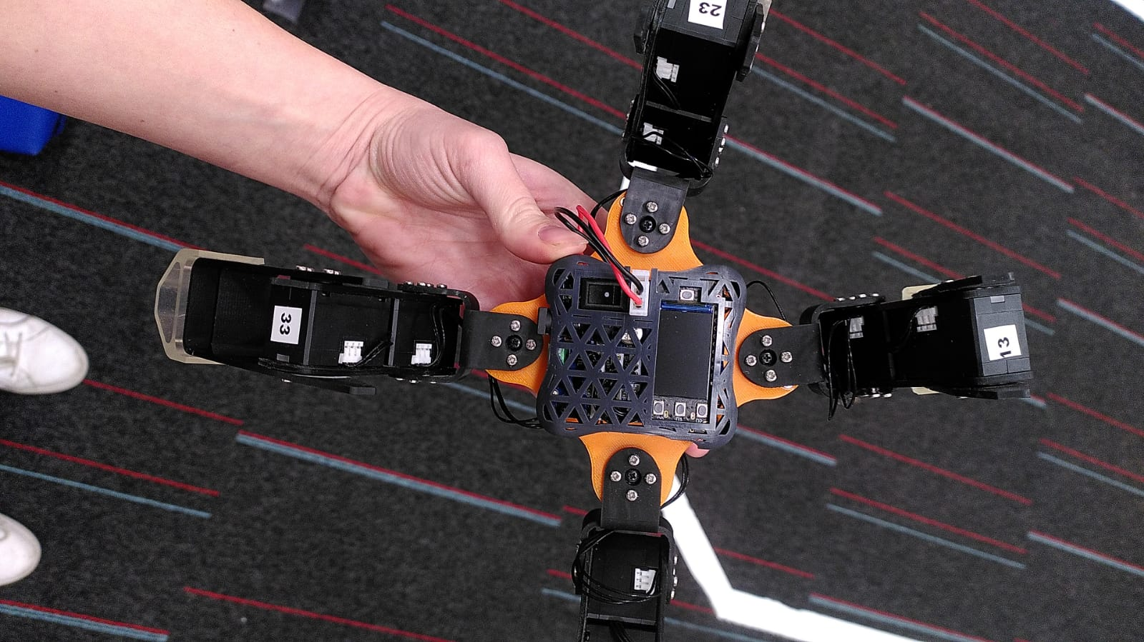

Slide 4
Quadruped
12 DoF
Sensing:
Proprioception (joint positions)
v2: Exteroception (IMU)
Acting
12 Dynamixel motors
Control:
Onboard
Off-board (wifi) v2
Battery power
Hardware and software:
https://github.com/adaptive-intelligent-robotics/Qutee_v2
Python
ROS2

Slide 5
Things to do
3D print
Update design for controller Adafruit ESP32-S3 TFT Feather ]
Wait for hardware to arrive (already purchased)
Assembly
Software:
Dynamixel Wizard (to control the motors)
Python (to put all together)
ROS2 to connect over network
Use our repo: git.napier.ac.uk (ask for access)
Clone original repo, work from there.
Build URDF file

Slide 6
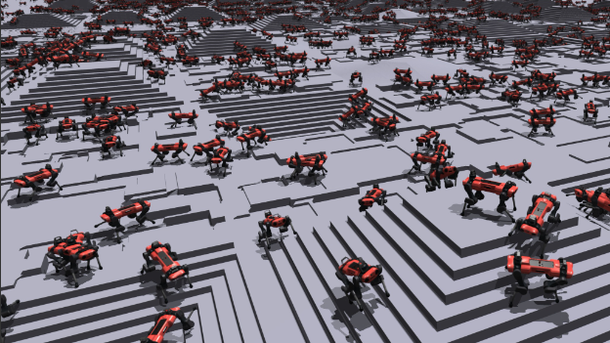
AI
Robust control
Navigation
Optimisation
SLAM
Other
Remote interface
Add arm
Use NVidia Isaac Gym for Machine learning
Reinforcement learning
Use Evolutionary Computation
Use ROS2 packages, for example SLAM

